Slide 1

University Institute of Liberal Arts and Humanities
Course Name – Communication Skills
Course Code – 23PCH-105
Reading and writing skills
DISCOVER . LEARN . EMPOWER

Slide 2
COURSE OBJECTIVES
The Course aims to:
1 | Augment students overall communication and interpersonal skills by making them realize the importance of good oral and written English Language in professional life.
2 | Enrich their reading capability with special emphasis on expanding vocabulary and grammatical formations.
3 | Build exceptional speaking, reading and writing skills by correcting grammatical errors and pronunciation through practice.
4 | Enhances soft skills by fostering self awareness, confidence and a positive attitude in students’ ability to communicate effectively in English.

Slide 3

Course Outcome
On completion, the students are expected to
CO Number | Title | Level
CO1 | Apply appropriate Listening, Speaking, Reading and Writing Skills (LSRW Skills) with correct non-verbal cues to attain expertise in soft skills. | Apply
CO2 | Apply correct contextual and comprehensible written text in the form of paragraph writing, short compositions business correspondence, using logical support and argument in a wide range of communication situations. | Apply
CO3 | Demonstrate linguistic competence while speaking and during presentations through accuracy in grammatical usage, vocabulary, pronunciation and intonation. | Apply
CO4 | Evaluate information as critical readers, speakers and writers applying ethics in communication and being sensitive in cross cultural communication. | Evaluate
CO5 | Create original, digital content for websites, blogs, vlogs and personal social media profiles etc. | Create
LinkedIn.com

Slide 4


Techniques for building RW Skills
“Reading is to mind what exercise is to body”
-Joseph Addison
Clip Art

Slide 5

Reading Skills
It is the process of looking at a series of written symbols and getting meaning from them.
Reading can be silent (in our head) or aloud (so that other people can hear).
lightinghomes.com

Slide 6
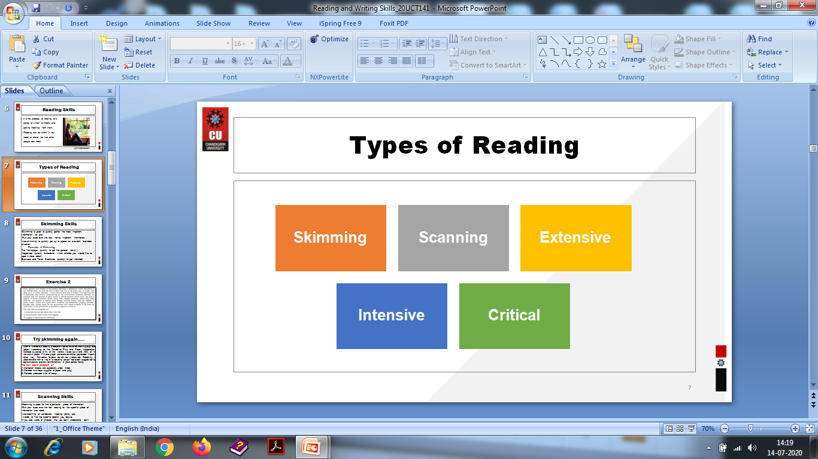
Types of Reading

Slide 7
Skimming Skills
Skimming is used to quickly gather the most important information, or 'gist'.
Run your eyes over the text, noting important information.
Use skimming to quickly get up to speed on a current business situation.
Examples of Skimming:
The Newspaper (quickly to get the general news )
Magazines (quickly to discover which articles you would like to read in more detail)
Business and Travel Brochures (quickly to get informed)

Slide 8
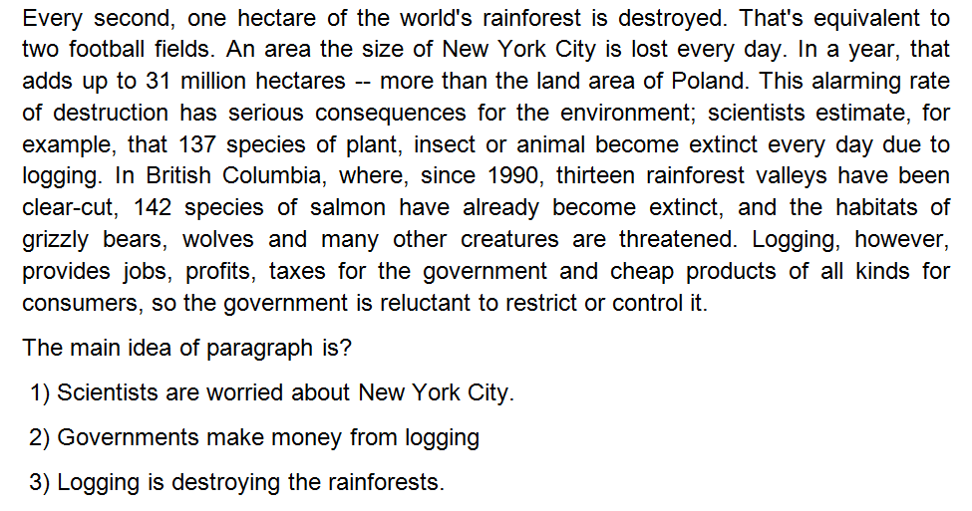
Exercise

Slide 9
Try skimming again…..
Much of Canada's forestry production goes towards making pulp and paper. According to the Canadian Pulp and Paper Association, Canada supplies 34% of the world's wood pulp and 49% of its newsprint paper. If these paper products could be produced in some other way, Canadian forests could be preserved. Recently, a possible alternative way of producing paper has been suggested by agriculturalists and environmentalists: a plant called hemp.
The main idea of paragraph is?
1) Canadian forests are especially under threat.
2) Canada is a major supplier of paper and pulp.
3) Canada produces a lot of hemp.

Slide 10
Scanning Skills
Scanning is used to find a particular piece of information.
Run your eyes over the text looking for the specific piece of information you need.
Use scanning on schedules, meeting plans, etc.
in order to find the specific details you require.
If you see words or phrases that you don't understand, don't worry when scanning.
Examples of Scanning
The "What's on TV" section of your newspaper.
A train / airplane schedule

Slide 11
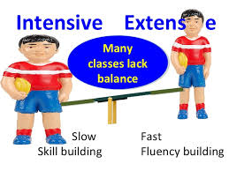
Extensive Reading Skills
Extensive reading is used to obtain a general understanding of a subject and includes reading longer texts for pleasure.
Use extensive reading skills to improve your general knowledge.
Do not worry if you do not understand each word. For Example
The latest marketing strategy book
A novel you read before going to bed
Magazine articles that interest you
lightinghomes.com

Slide 12
Intensive Reading Skills
Intensive reading is used on shorter texts in order to extract specific information.
It includes very close accurate reading for detail.
Use intensive reading skills to grasp the details of a specific situation.
In this case, it is important that you understand each word, number or fact.
Examples of Intensive Reading
An insurance claim
A contract of employment
Buzzle.com

Slide 13

Critical Reading Skills
Language analysis that does not take given text at face value, but involves a deeper examination of supporting points.
Critical readers recognize not only what a text says, but also how that text portrays the subject matter.
What a text means – interpretation, analysis of the text
theconversation.com

Slide 14
Poll Question
What do you usually like to read?
1) Novels, short story, poem
2) Newspaper
3) Non-fiction
4) None

Slide 15
Ways to improve Reading Skills
Read about things that interest you.
Read material that is at your level of understanding or just a little more difficult for you to comprehend.
Ask yourself questions while reading and after reading.
Read many kinds of texts.
Let your imagination get involved.
Listen to audio books and follow the text at the same time.
Find a place to read where you can concentrate.

Slide 16
REFERENCES
http://www.wikihow.com/Improve-Your-Reading-Skills
http://www.fluentu.com/english/blog/how-to-improve-english-reading/?lang=en
https://www.pickthebrain.com/blog/7-pleasurable-ways-to-improve-your-reading-ability/

Slide 17

Writing Skills
To communicate specific information or ideas, utilizing the formats, language and content relevant to the workplace.
Writing involves encoding of message as we translate our thoughts into language.
TutZone.com

Slide 18
Good writing
Completeness: all information needed is provided.
Correctness: relevant and precise information.
Credibility: support your argument.
Clarity :should not be vague, confusing and ambiguous.
Conciseness: to the point.
Considerations: anticipate the reader’s reactions.
Vitality: use the active voice rather than passive voice.

Slide 19
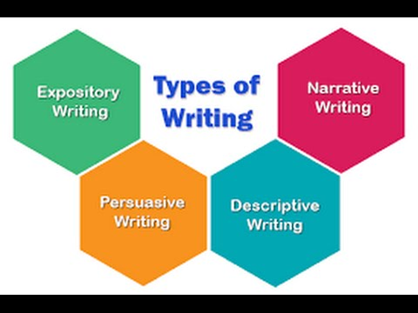
Types of Writing
EnglishEdurite.com

Slide 20

Narrative Writing
Recounts a personal experience in the form of a story and always includes characters, setting, and plot
Examples: short story, novel, narrative poem, journal
hhamlyn.wordpress.com

Slide 21
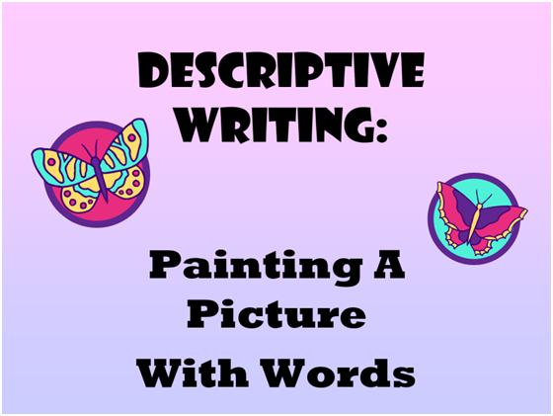
Descriptive Writing
Uses vivid images to describe a person, place, or event so that the topic can be clearly “seen” in the reader’s mind.
Examples: menu, travel brochure, poster
Tes.com

Slide 22
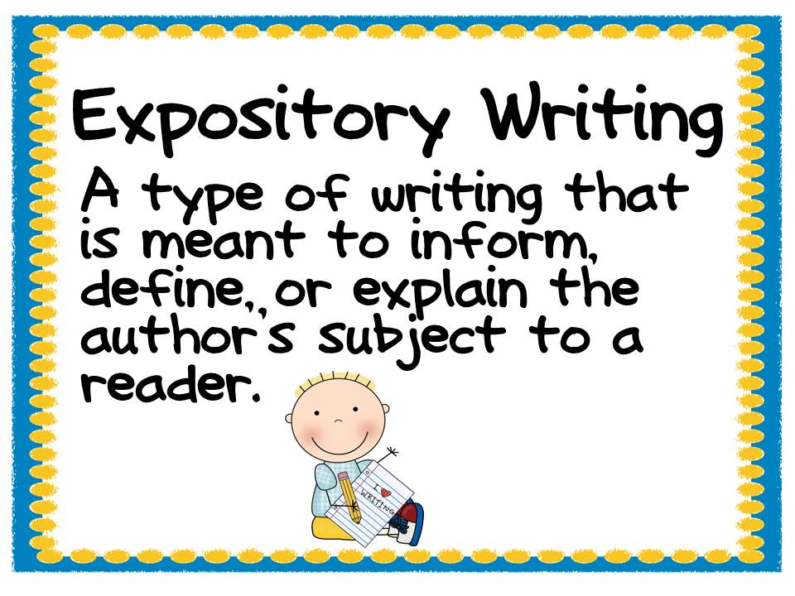
Expository Writing
Provides information that explains, clarifies or defines
Examples: essay, research paper, report, manual
Pins daddy.com

Slide 23

Persuasive Writing
Gives an opinion using facts that attempts to convince a reader to agree with a writer’s belief
Examples: movie review, restaurant critique, letter to a newspaper editor, essay
ashfordstudentblog.blogspot.com

Slide 24

Creative Writing
Entertains the reader
Examples: short story, novel, poem, play
Success magazine. in

Slide 25
Poll Question
Is Coca-Cola or Pepsi better? Choose the STRONGEST claim:
1) Coke is better than Pepsi because more people in the world like it.
2) I believe Pepsi is better because it tastes better than Coke.
3) Coca-Cola is better a drink than Pepsi.
4) Coca-Cola has more sales and flavor options, and therefore, is better than Pepsi.

Slide 26

The writing process
PLANNING: keep objectives in mind and research the topic.
WRITING: Inspiration is acceptable but must be carefully reviewed.
QUALITY CONTROL: Reread your work and be critical of your own work.
atozindia.inca

Slide 27

Tips for Effective Writing
Put the reader first.
Use simple words and short sentences.
Use jargon only when necessary.
Use of appropriate punctuation, grammar and correct spellings are essential for effective writing.
Use multiple examples to clarify your point in each paragraph. Each point should include only one main topic.
Clip Art

Slide 28

Tips for Effective Writing
When you begin writing, don’t forget to have a solid introduction.
Make sure your entire writing is in the same tense.
Using formal language is essential.
Longer sentences are not necessarily better.
Eliminate unnecessary words and phrases.
Clip art

Slide 29
Coherence
Coherence in writing is the "logical glue" that allows readers to move easily and clearly from one idea to the next.
Coherence in writing is much more difficult to sustain than coherent speech because writers have no nonverbal clues to inform them if their message is clear or not.

Slide 30
Things to Remember
Avoid using contractions like can’t, wouldn't etc.
Do not use words like very, really, a lot.
Replace weak verbs with strong verbs.
Prepare set of phrases to be used while writing .
Read right material that enhances the writing skills.

Slide 31
Practice Exercise
Write a story entirely in dialogue, having one side of the conversation unspoken [redacted]. Make sure the reader can guess at what the redacted parts are by what the other character says.
Make a list of the top five fears in your life. Write a character who is forced to confront one of those fears.
Create a minor character based upon someone you dislike. Now have your main character encounter them and feel sympathy and empathy for them despite their faults.

Slide 32
Application
Helps to express opinions properly.
Helps to communicate properly by developing an understanding and report the work in informative, concise, and professional formats.
Helps to discover the creative side of people.
Helps to discover imagination and discover new things.
Helps to become clear, focused, and accurate about our opinions.

Slide 33
Assessment Pattern
Students are assessed on the basis of the following parameters:
Hourly Tests - 2
Assignments
Surprise Test
Quiz
Student Engagement
End Semester Exam

Slide 34
References
https://www.skillsyouneed.com/writing-skills.html.
https://www.mindtools.com.
ww.wordstream.com/blog/ws/2014/08/07/improve-writing-skills.
https://www.shoutmeloud.com/10-tips-to-improve-your-writing-skill.html.

Slide 35
THANK YOU
For queries
Email: communicationskills.uilah@gmail.com

